Slide 1
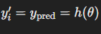
Linear Regression – Single Variable
In SLR, the relationship between a response variable ypred and a predictor variable xi is postulated as:
where θ0 and θ1 are constants called the model regression coefficients (weights or parameters)

Slide 2
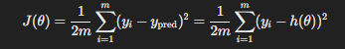
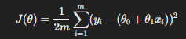
Linear Regression
The parameters θ0 and θ1 are unknown and must be estimated using sample data
(x1, y1),(x2, y2), · · · ,(xn, yn)
The least squares method is used to estimate θ0 and θ1. To do this, from
we write error mor cost function as
or

Slide 3
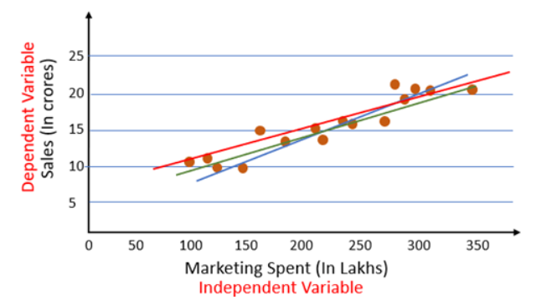
How to decide which weights are best?

Slide 4
Gradient Descent

Slide 5
Motivation to use gradient descent to optimize cost function

Slide 6
Function Example

Slide 7
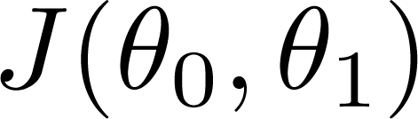
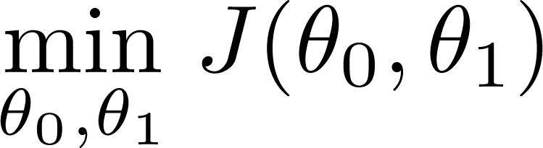
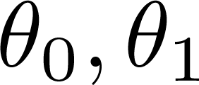
Have some cost function
Want
Outline:
Start with some
Keep changing to reduce until we hopefully end up at a minima or maxima

Slide 8
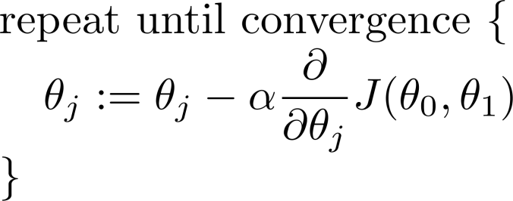
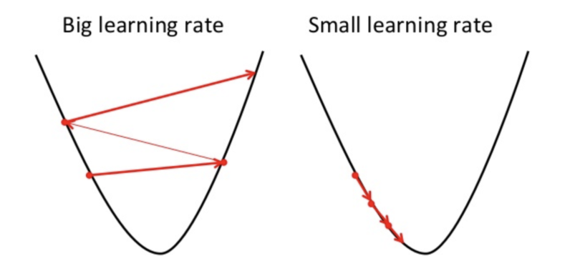
Gradient descent algorithm
where α represents the learning rate in gradient descent. It controls the size of the steps we take during each iteration of the gradient descent algorithm to optimize the cost function.
If α is too large: The updates might "overshoot" the minimum, causing the algorithm to diverge rather than converge
If α is too small: The algorithm will converge, but very slowly, requiring more iterations to reach the minimum

Slide 9
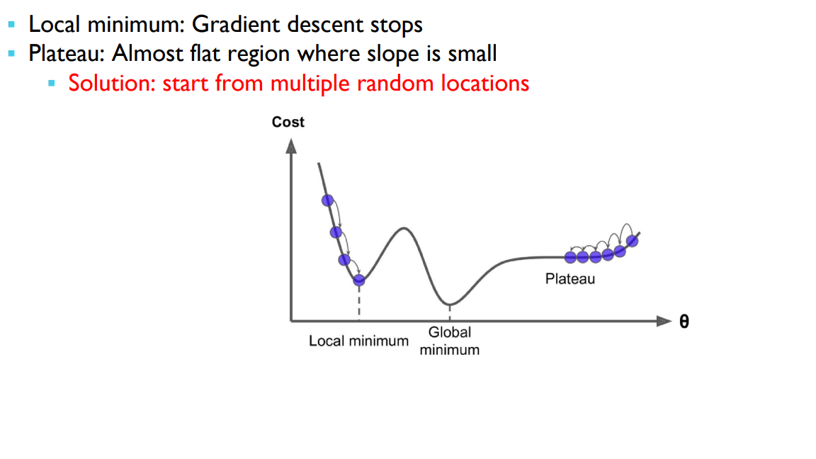

Slide 10
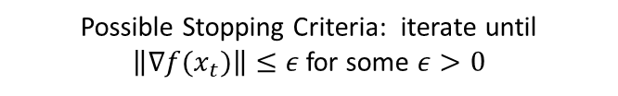
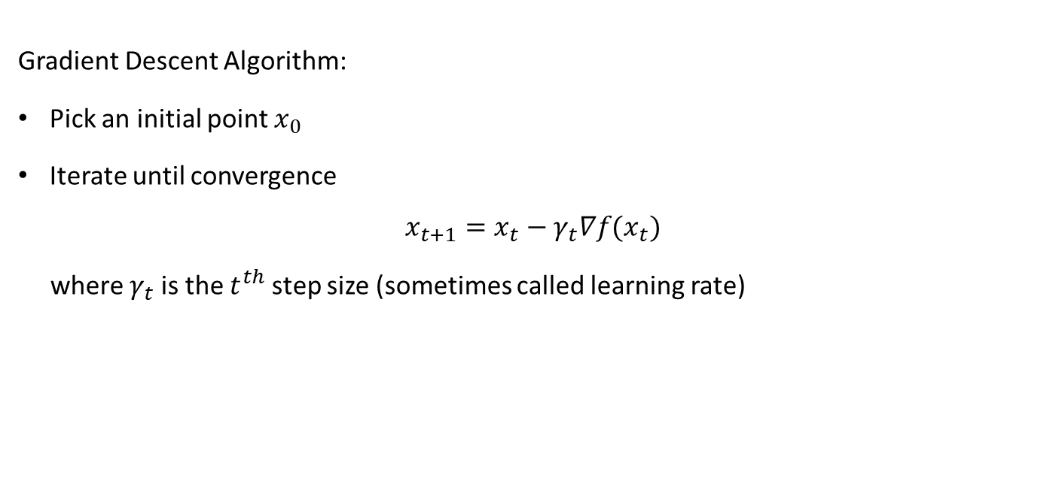

Gradient Descent
Gradient Descent Algorithm:
Pick an initial point $x_{0}$
Iterate until convergence
$$x_{t+1}=x_{t}−γ_{t}∇f(x_{t})$$
where $γ_{t}$ is the $t^{th}$ step size (sometimes called learning rate)
Possible Stopping Criteria: iterate until $\left\|∇f(x_{t})\right\|≤ε$ for some $ε>0$
How small should $ε$ be?

Slide 11
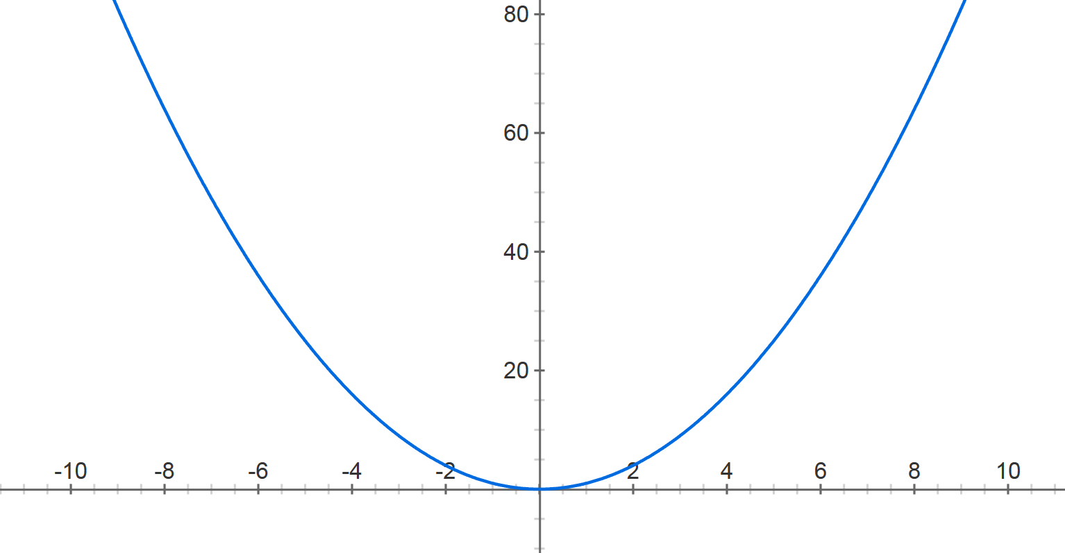
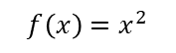
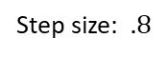
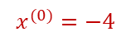
Gradient Descent
$$f\left(x\right)=x^{2}$$
Step size: $.8$
$$x^{(0)}=−4$$

Slide 12

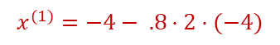
Gradient Descent
$$f\left(x\right)=x^{2}$$
Step size: $.8$
$$x^{(0)}=−4$$
$$x^{(1)}=−4− .8⋅2⋅(−4)$$

Slide 13
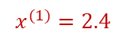
Gradient Descent
$$f\left(x\right)=x^{2}$$
Step size: $.8$
$$x^{(0)}=−4$$
$$x^{(1)}=2.4$$

Slide 14

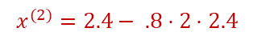
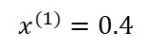
Gradient Descent
$$f\left(x\right)=x^{2}$$
Step size: $.8$
$$x^{(0)}=−4$$
$$x^{(1)}=2.4$$
$$x^{(2)}=2.4− .8⋅2⋅2.4$$
$$x^{(1)}=0.4$$

Slide 15
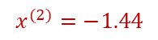
Gradient Descent
$$f\left(x\right)=x^{2}$$
Step size: $.8$
$$x^{(0)}=−4$$
$$x^{(1)}=2.4$$
$$x^{(2)}=−1.44$$

Slide 16
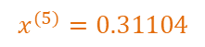
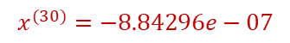
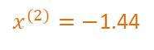
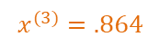
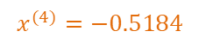
Gradient Descent
$$f\left(x\right)=x^{2}$$
Step size: $.8$
$$x^{(0)}=−4$$
$$x^{(1)}=2.4$$
$x^{(2)}=−$1.44
$$x^{(3)}=.864$$
$$x^{(4)}=−0.5184$$
$$x^{(5)}=0.31104$$
$$x^{(30)}=−8.84296e−07$$

Slide 17
Gradient Descent for Linear Regression

Slide 18
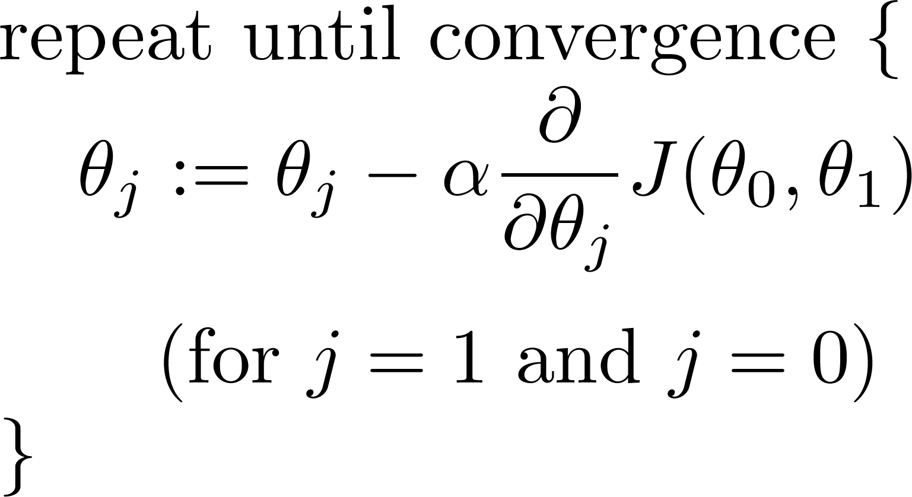

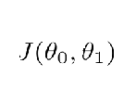
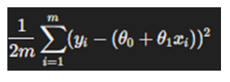
Gradient descent algorithm
Linear Regression Model

Slide 19
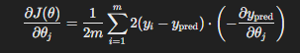
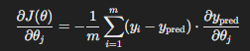
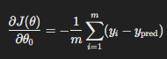
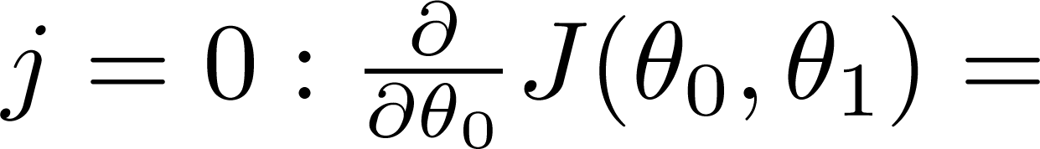
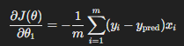
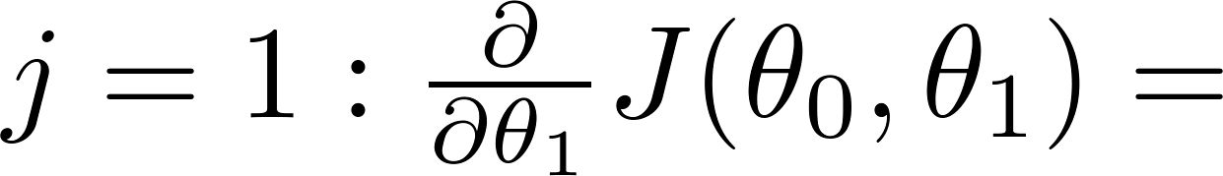

Slide 20
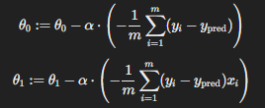
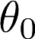
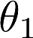
Gradient descent algorithm
Repeat until convergence
update
and
simultaneously

Slide 21
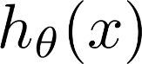
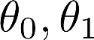
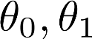
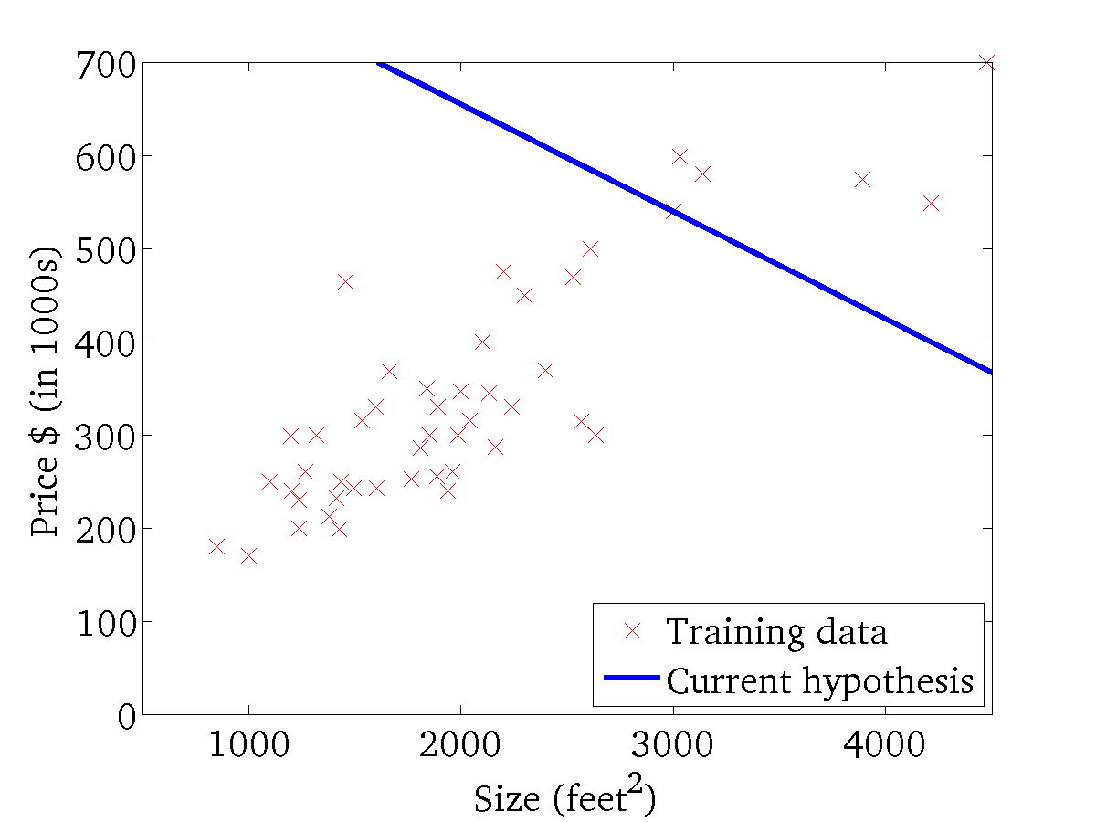
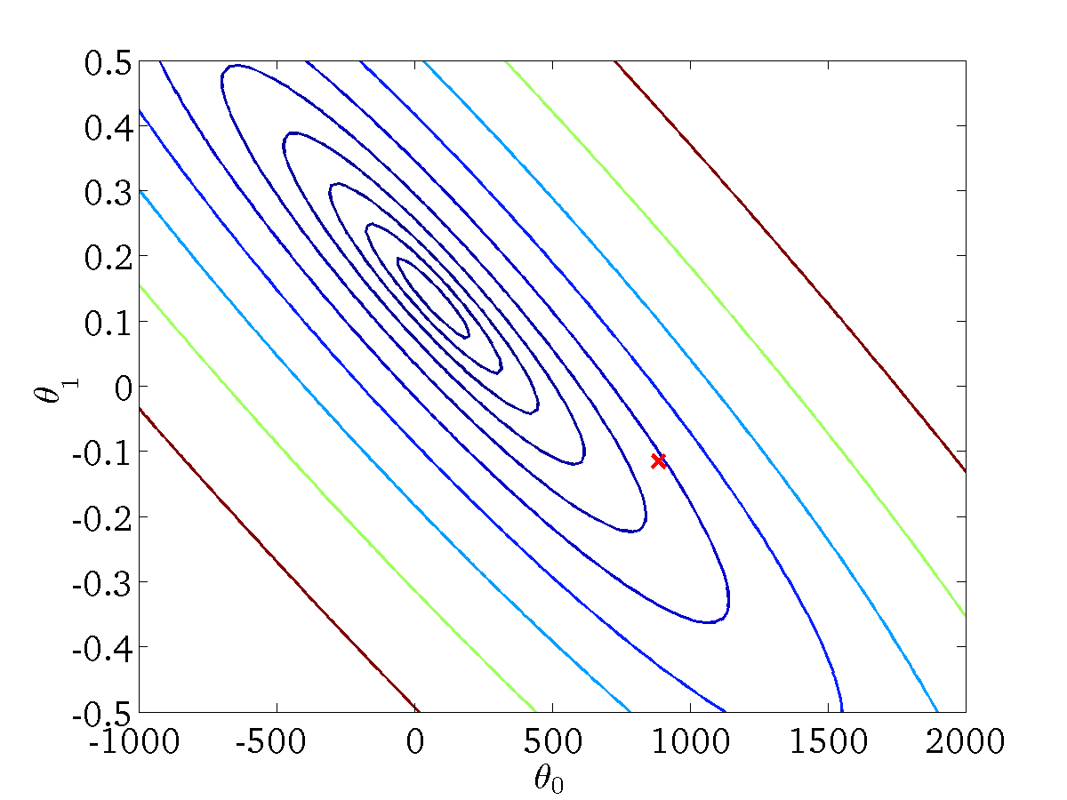
(for fixed , this is a function of x)
(function of the parameters )

Slide 22
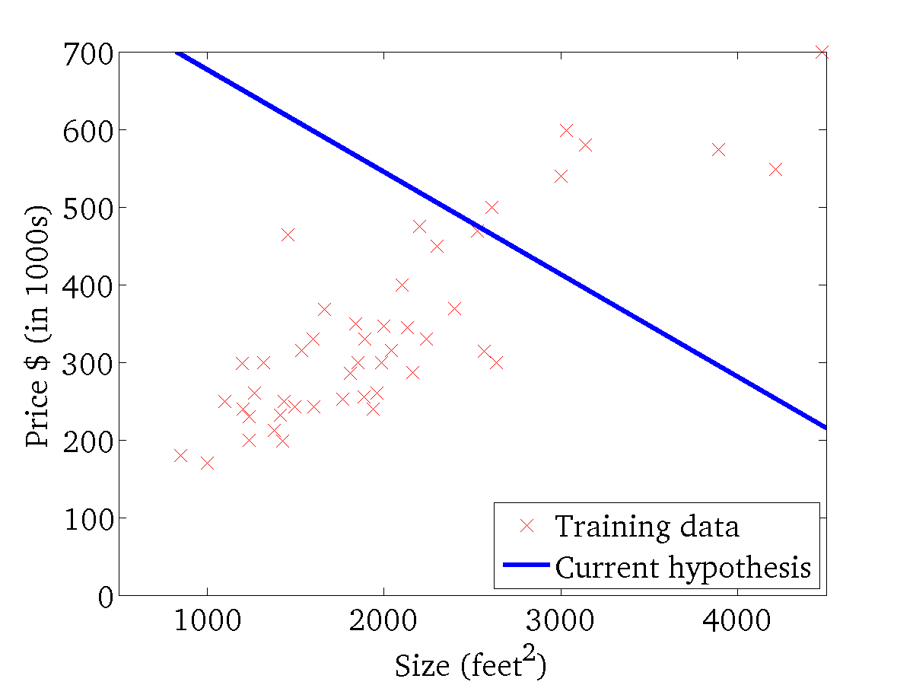

(for fixed , this is a function of x)
(function of the parameters )

Slide 23
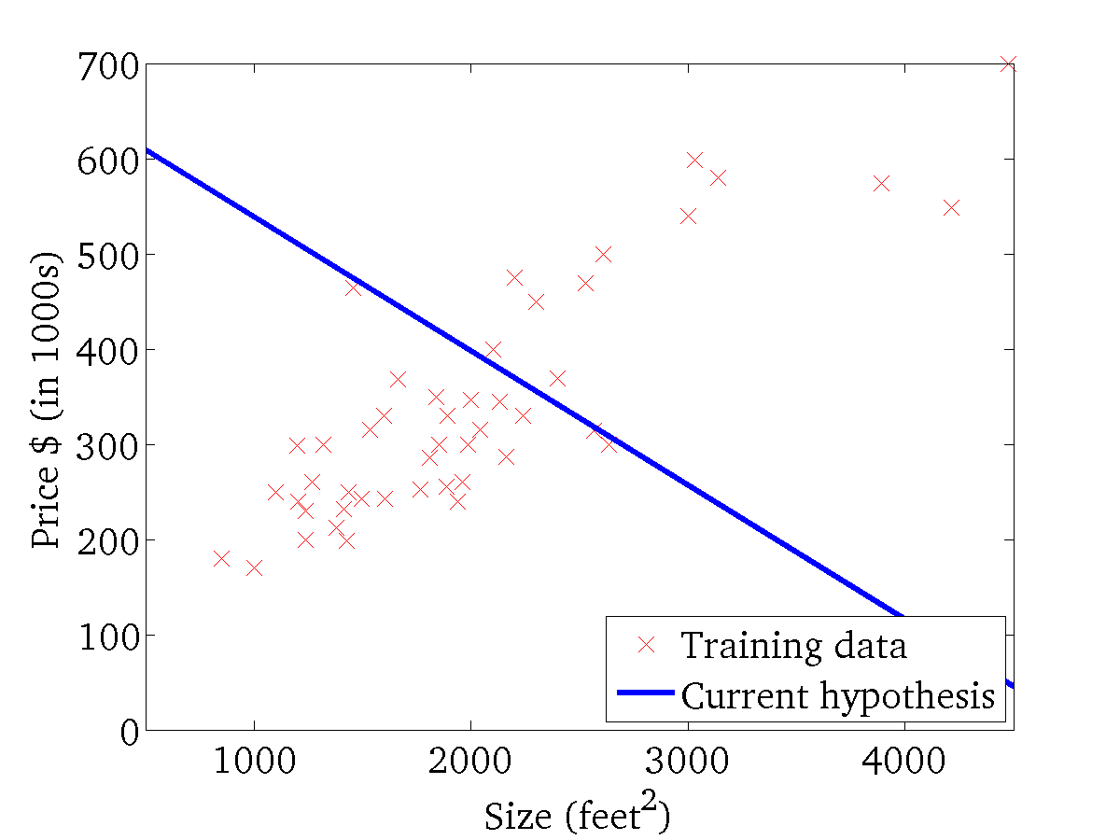
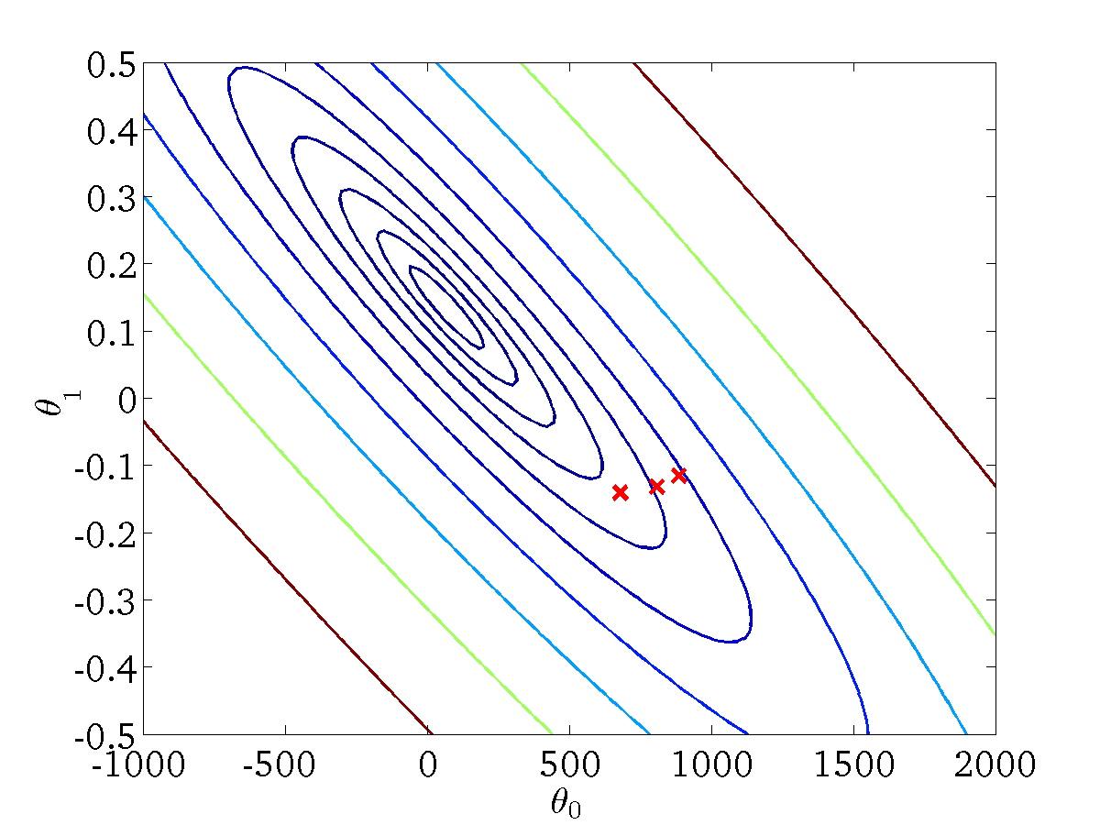
(for fixed , this is a function of x)
(function of the parameters )

Slide 24
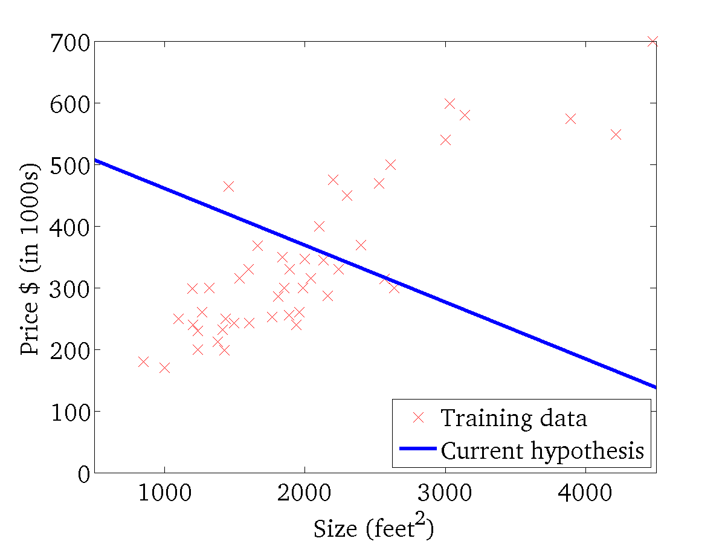

(for fixed , this is a function of x)
(function of the parameters )

Slide 25
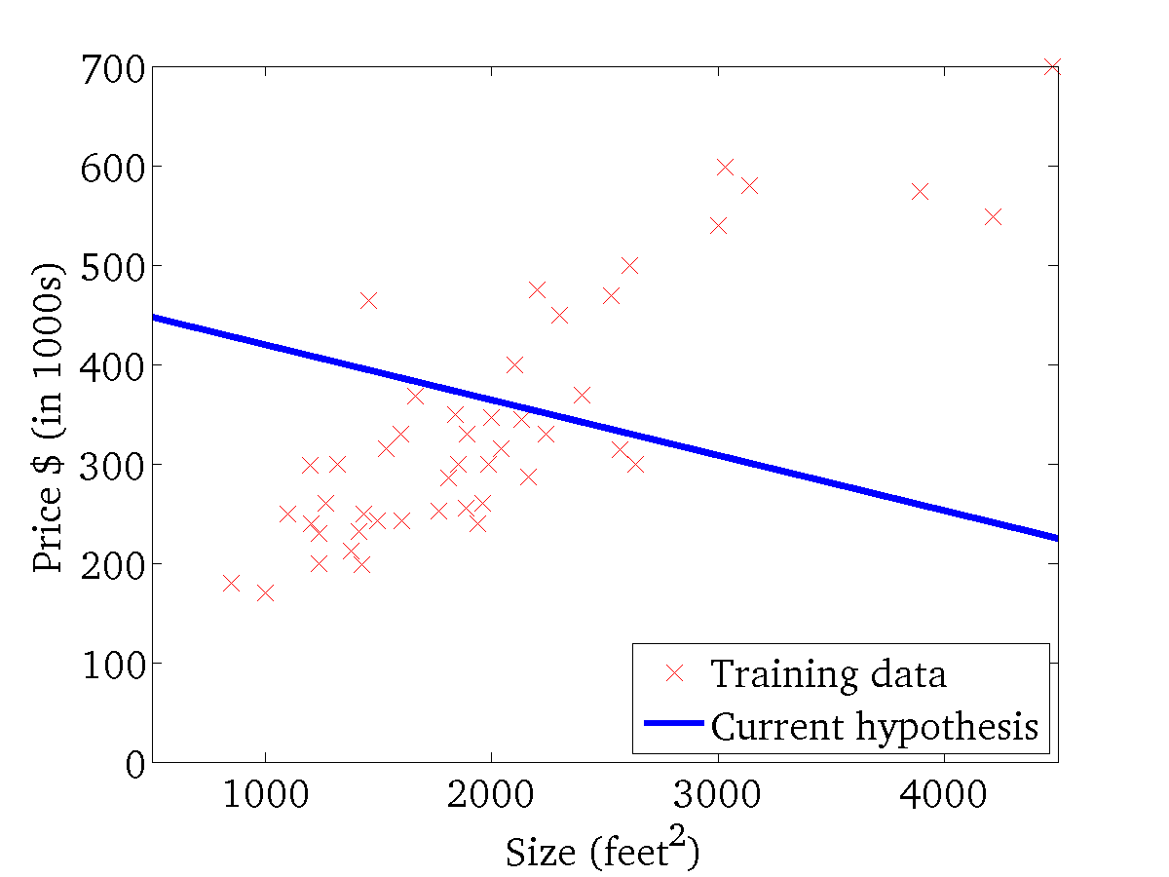
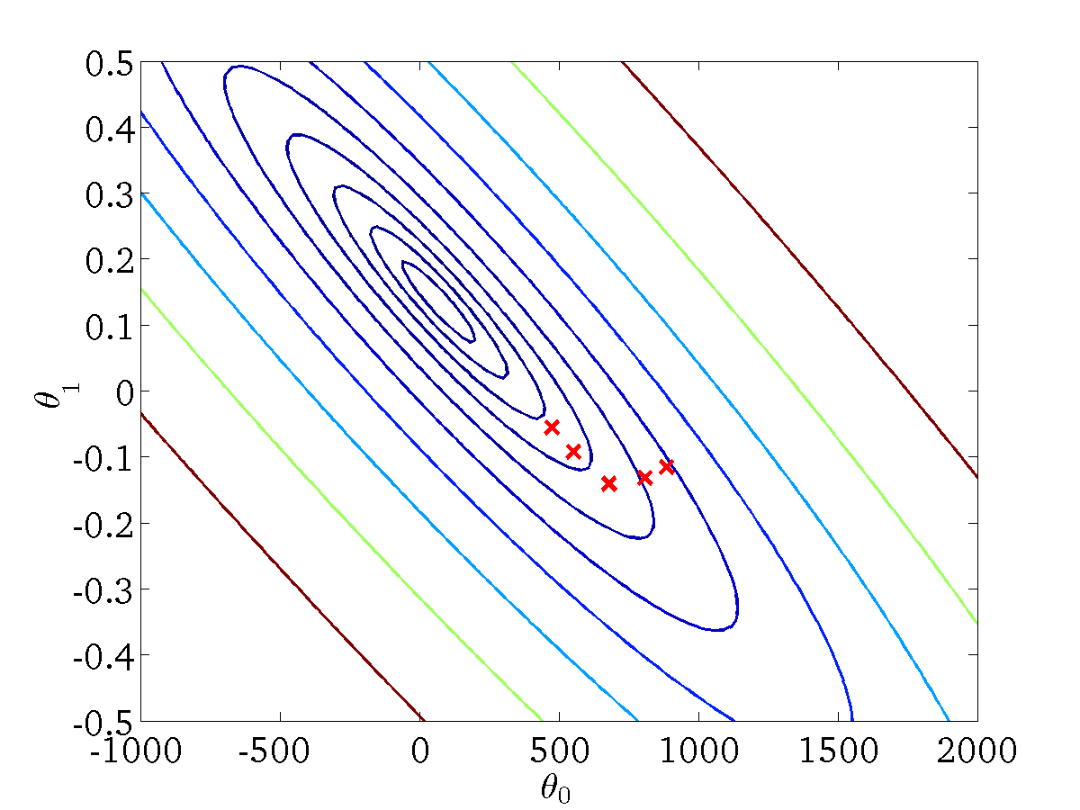
(for fixed , this is a function of x)
(function of the parameters )

Slide 26
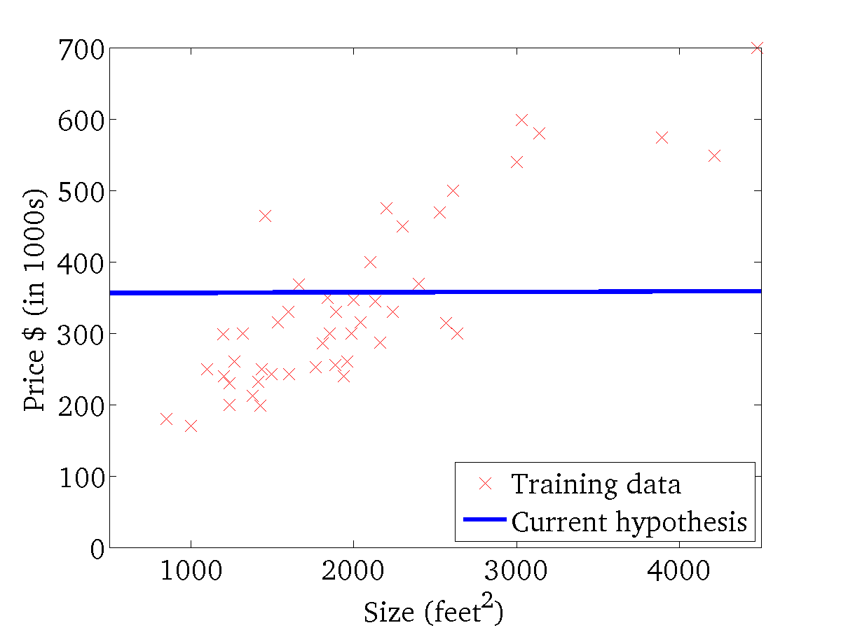

(for fixed , this is a function of x)
(function of the parameters )

Slide 27


(for fixed , this is a function of x)
(function of the parameters )

Slide 28


(for fixed , this is a function of x)
(function of the parameters )

Slide 29


(for fixed , this is a function of x)
(function of the parameters )

Slide 30
“Batch” Gradient Descent
“Batch”: Each weight update using gradient descent uses all the training examples.
Weight update every epoch

Slide 31


Slide 32


Slide 33
Example:
Dataset with four examples and two features
x1 | x2 | y (actual)
0 | 3 | 1
4 | 6 | 1
7 | 9 | 2
10 | 0 | 0

Slide 34

Batch Gradient Descent

Slide 35


Slide 36


Slide 37

Stochastic GD

Slide 38


Slide 39


Slide 40

Mini Batch GD

Slide 41


